Slide 1

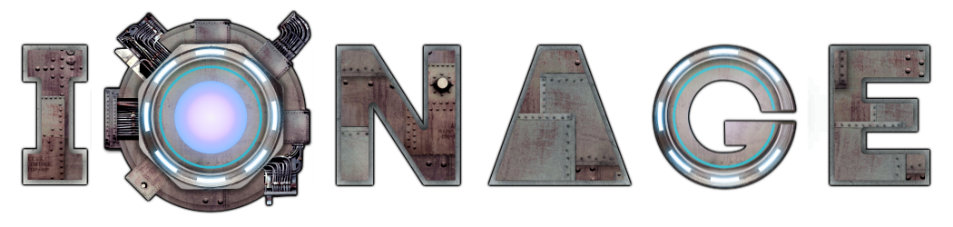

Making…
Tim Wicksteed
@twicecircled
29/08/13

Slide 2
The Checklist
We need to think about the following:
Idea
Platform/Tools/Market
Development
Testing
Monetisation
Launch

Slide 3
1. Idea
Mechanics
Story
Aesthetics
Technology
“… Be a pretentious creative not a corporate handle turner.”
Tim Wicksteed 2013
#bapcnacht

Slide 4
2. Platform/Tools/Market
Match to your game idea… I didn’t
Java/Android
  Large and growing
  Development was easy
  Not cross platform
  Difficult to port
  Difficult user base
Build own engine/use someone else’s?
Next game? Unity/PC probably…

Slide 5
3. Development
Fixed deadlines – flexible scope
Endless or level based
Multi-player considerations

Slide 6
4. Testing
Minimum viable product
Welcome critical feedback
…but the user’s not always right
Use to build fanbase/promote early
Dev diaries

Slide 7
5. Monetisation
Ionage is F2P:
  Seems right for Android
  It’s about your user, not you
  Maximum exposure
  Doesn’t have to be ‘evil’
  Probably needs social mechanics
  Waste time on free users

Slide 8
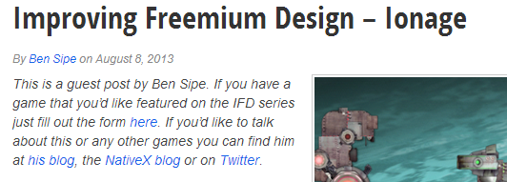
6. Launch
Big gaming news sites
Smaller review sites
Gaming podcasts
Write articles
Get others to write articles
Reddit

Slide 9
Conclusion/Numbers
Numbers 26/08/13 (1 month after launch):
Downloads – 8500
Total revenue – £458
Per day – ~£15
Conversion rate – 2.3% (3.7% in UK*)
ARPU – 5p
Engagement – ~10% current users play each day
User reviews – 87% gave 5*
Critical reviews – generally positive, 4*

Slide 10
References
The Art of Game Design by Jesse Schell
Getting Real by 37 Signals

