Slide 1
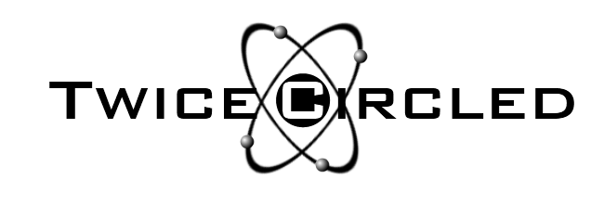
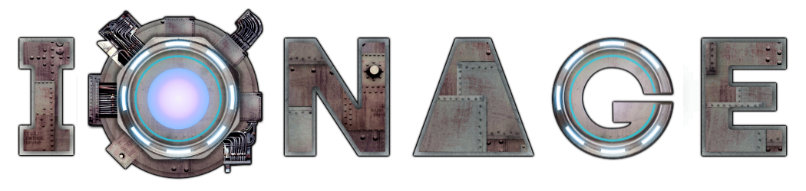

5 Mistakes and Lessons from an Indie Developer
Tim Wicksteed
@twicecircled

Slide 2

1. Worried about the wrong audience
“Great game! This is one of those ‘just one more try’ games - very addictive… My only criticism is having to buy upgrades (which I have) to get better weapons, etc... I'd far sooner pay outright for a game.”
“I would most definitely recommend. The only negative is IAP… While this is the best form of IAP I have seen, it would have been far better to just pay for the game… Still without a doubt a five star game.”
“Meh All the upgrades I have available to get require I spend money.”
“pay to win otherwise imbalanced after a few levels and not fun anymore”

Slide 3
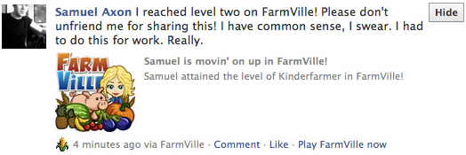
2. Saw social integration as a liability instead of an opportunity
*
“Now that i got you, have you thought about adding Play Games achievements to the game?”
“The only thing I think this game needs are Google achievements and multi-player/online mode/infinite mode”
*Source http://pondstonecommunications.wordpress.com/2010/02/23/how-to-block-farmville-from-facebook-once-and-for-all/

Slide 4
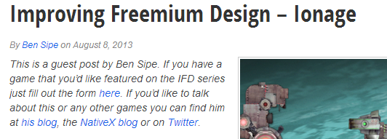
3. Concentrated on quantity over quality of PR
Big gaming news sites
Smaller review sites
Gaming podcasts
Write articles
Get others to write articles
Reddit

Slide 5
4. Didn’t value my game highly enough
Paid acquisitions cost > $1 per free user
Generated over 12000 organic users to date
… £700 from IAPs
Could have made 17x the amount by sending traffic to ANOTHER GAME
Is permanent, non-consumable a valid option?
Yeah (I think…)

Slide 6



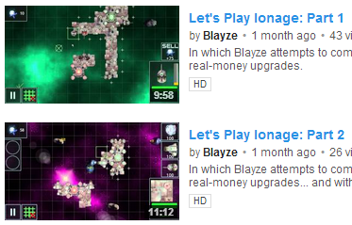
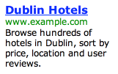


5. Didn’t allow my free users to contribute
Money rich/time poor
Time rich/money poor
Time-based contributions:
Share/Invite
Friends
User generated
content
Advertising

Slide 7
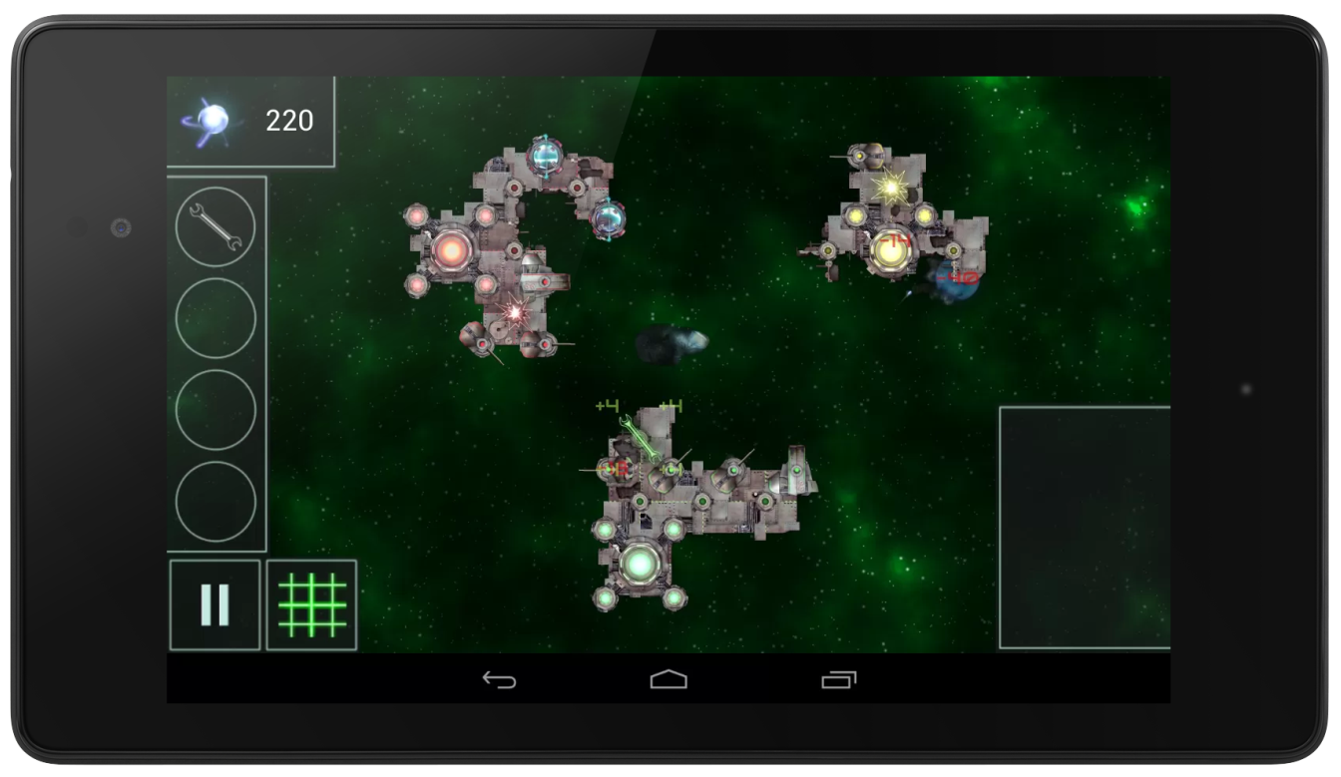
Slides available at twicecircled.com
Contact:
Tim Wicksteed
tim@twicecircled.com
@twicecircled

